Slide 1

Sri Krishna Arts and Science College Department of Computer Technology and Data Science Academic Year 2023-2026 Industrial Exposure Training Project
ADOPT NEST: PET ADOPTION WEBPAGE
Under the Guidance
Mr. R. SHANKAR, M.Sc., MCA., M.Phil., (Ph. D).,
Assistant Professor
Department Of Computer Technology and Data Science
Name : Gurucharan K
Roll No: 23BCT021
Class : III B.Sc. CT A

Slide 2
AGENDA
Organization Profile
Abstract
Introduction
Existing System
Proposed System
Technical Diagram
Table Structure
Modules
Software Testing
Conclusion and Future Enhancement
Screenshots

Slide 3

ORGANIZATION PROFILE
Profenaa Groups (Profenaa) is a training and education-oriented organization based in Coimbatore, comprised of experienced professionals dedicated to teaching and job placement. Profenaa offers cutting-edge technical training in areas such as Python, 3ds Max, SolidWorks, Machine Learning, and Artificial Intelligence. They provide structured on-the-job training (OJT), skill certifications, and international placement support. Many of their learners have gone on to secure positions in leading multinational corporations (MNCs)

Slide 4
ABSTRACT
Growing number of stray animals and increasing concern for animal welfare highlight the need for organized adoption platforms.
AdoptNest is a web-based pet adoption management system designed to streamline the adoption process.
Acts as a centralized hub for individuals to discover pets available for adoption and connect with pet providers.
Offers detailed pet profiles including species, breed, age, health, vaccination status, and temperament.
Promotes responsible and ethical adoption by ensuring transparency and access to complete pet information.
Includes modules for adoption requests, health tracking, blogs, and application tracking.
Simplifies processes, reduces paperwork, and enhances communication between adopters and providers.

Slide 5
INTRODUCTION
Purpose of AdoptNest
The main purpose of AdoptNest is to simplify the pet adoption process by providing an online platform where users can find pets, view their details, and adopt them easily. It aims to reduce manual work, improve communication between adopters and pet providers, and promote responsible pet ownership.
Why This System is Important
Raises awareness about adopting pets instead of buying.
Helps reduce the number of stray and abandoned animals.
Makes the adoption process easier, faster, and more transparent.
Provides complete information about pets, including health and vaccination records, helping adopters make better decisions.

Slide 6
EXISTING SYSTEM
Pet adoption is done manually, which is slow and confusing.
No single place to check all pet details.
Hard for adopters and pet owners to talk and share information easily.
Pet health and background details are not clear or easy to find.

Slide 7
PROPOSED SYSTEM
AdoptNest is a web-based system that replaces manual pet adoption processes with a centralized digital platform.
Users can browse pets with detailed profiles including images, breed, age, health status, and vaccination records.
The platform features a user-friendly interface for submitting adoption requests, tracking status, and contacting pet providers.
A secure database manages pet data, health records, user profiles, and adoption history.
Includes a blog section with educational content on pet care and responsible adoption.
Aims to boost adoption rates, improve user experience, and support animal welfare.

Slide 8
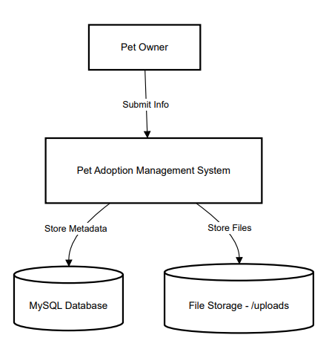
TECHNICAL DESIGN DIAGRAM
DATA FLOW DIAGRAM (LEVEL 0)

Slide 9
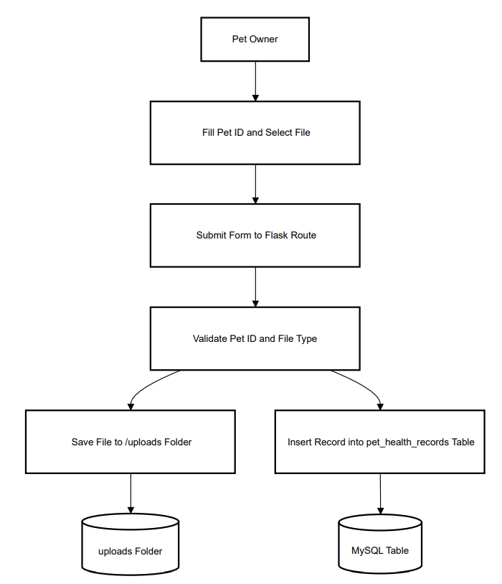
TECHNICAL DESIGN DIAGRAM
DATA FLOW DIAGRAM (LEVEL 1)

Slide 10
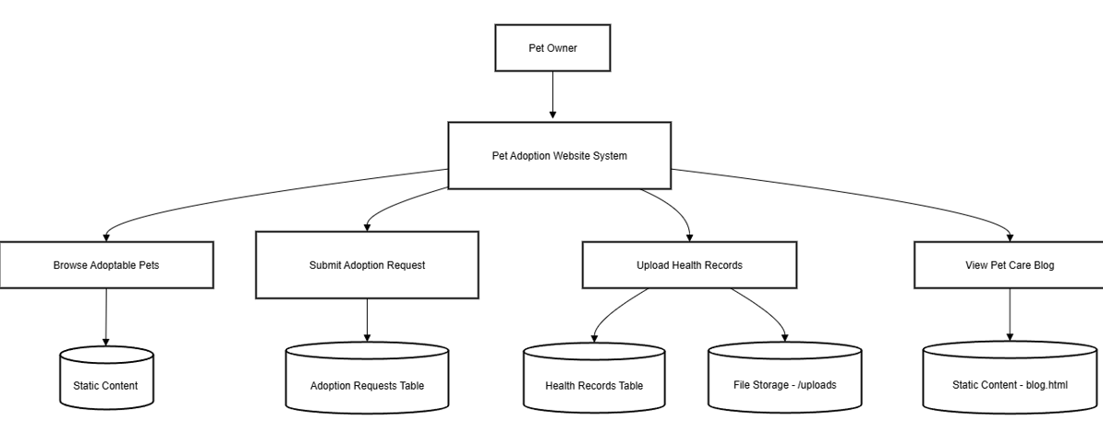
TECHNICAL DESIGN DIAGRAM
DATA FLOW DIAGRAM (LEVEL 2)

Slide 11
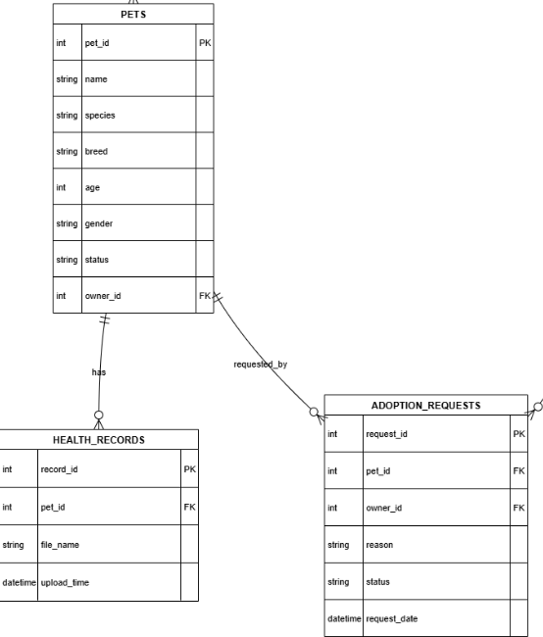
TECHNICAL DESIGN DIAGRAM
ER DIAGRAM

Slide 12
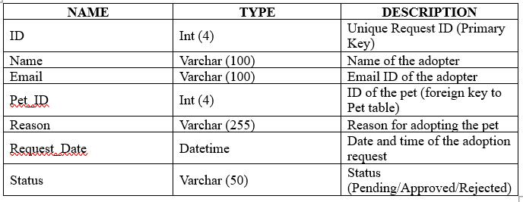
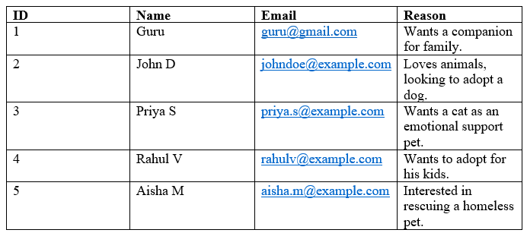
DATABASE DESIGN
Table Name: Adoption_Requests Primary Key: ID
Table structure
Data Table

Slide 13
MODULE DESCRIPTION
The AdoptNest – Pet Adoption Management System is designed with a modular approach to ensure that each function of the system operates effectively and independently while contributing to the overall workflow.
USER MODULE
BROWSE PETS MODULE
ADOPTION REQUEST MODULE
HEALTH TRACKING MODULE
ADOPTION TRACKER MODULE
BLOG MODULE

Slide 14
MODULE DESCRIPTION
1. User Module
Handles user registration and login functionality.
Allows users to create and update personal profiles.
Stores user credentials securely and maintains access control.
Enables role-based access (e.g., adopter, provider, admin).

Slide 15
MODULE DESCRIPTION
2. Browse Pets Module
Displays all pets available for adoption with filter/search options.
Each pet profile includes photo, breed, age, gender, health, and description.
Allows admins/providers to add, update, or remove pet listings.
Helps adopters make informed decisions based on pet details.

Slide 16
MODULE DESCRIPTION
3. Adoption Request Module
Allows users to submit adoption requests for selected pets.
Captures adopter details, reasons for adoption, and preferences.
Users can view, edit, or cancel requests as needed.
Facilitates communication between adopters and pet providers.

Slide 17
MODULE DESCRIPTION
4. Health Tracking Module
Maintains medical records and vaccination history of each pet.
Tracks regular health checkups and treatments.
Ensures adopters have transparency regarding pet health.
Helps providers update and manage pet health efficiently.

Slide 18
MODULE DESCRIPTION
5. Adoption Tracker Module
Enables users to track the progress of their adoption applications.
Displays status updates like: Pending, Approved, In Process, Completed.
Promotes transparency and improves communication flow.
Sends alerts or notifications for any changes in status.

Slide 19
MODULE DESCRIPTION
6. Blog Module
Hosts educational articles on pet care, training, health, and adoption tips.
Encourages responsible pet ownership through informative content.
Updated regularly to keep users engaged and aware.
Acts as a resource hub for both new and experienced pet owners.

Slide 20
SOFTWARE TESTING
UNIT TESTING
Unit testing involves testing individual components such as user registration, login authentication, form validations, and database CRUD operations. It ensures that each module works independently and correctly.
Test Case: Test the adoption request form validation that checks whether all mandatory fields are filled.
Output: Verify that if a required field (e.g., pet ID or user ID) is empty, an appropriate error message is displayed, and the form is not submitted until corrected.

Slide 21
SOFTWARE TESTING
INTEGRATION TESTING
Integration testing checks whether different modules (e.g., login, pet listings, adoption request, and database) interact correctly. It ensures data flows seamlessly between the frontend, backend, and database.
Test Case: Test the flow from user login → viewing pet listings → submitting an adoption request.
Output: Verify that after logging in, users can view pets, submit an adoption request, and the request is saved in the database, visible to the admin for approval.

Slide 22
CONCLUSION & FUTURE ENHANCEMENT
AdoptNest is a user-friendly web platform for managing pet adoptions.It connects pet seekers with shelters, rescues, or individual pet owners.
Future Enhancement – Key Points
Create a mobile app for easier access anywhere, anytime.
Use AI to recommend pets based on user preferences and lifestyle.
Add real-time chat between adopters and pet providers.
Send automated notifications via email or SMS.
Add payment gateways for donations or adoption fees.
Introduce virtual pet meetups using video calls.
Support multiple languages for a wider audience.

Slide 23
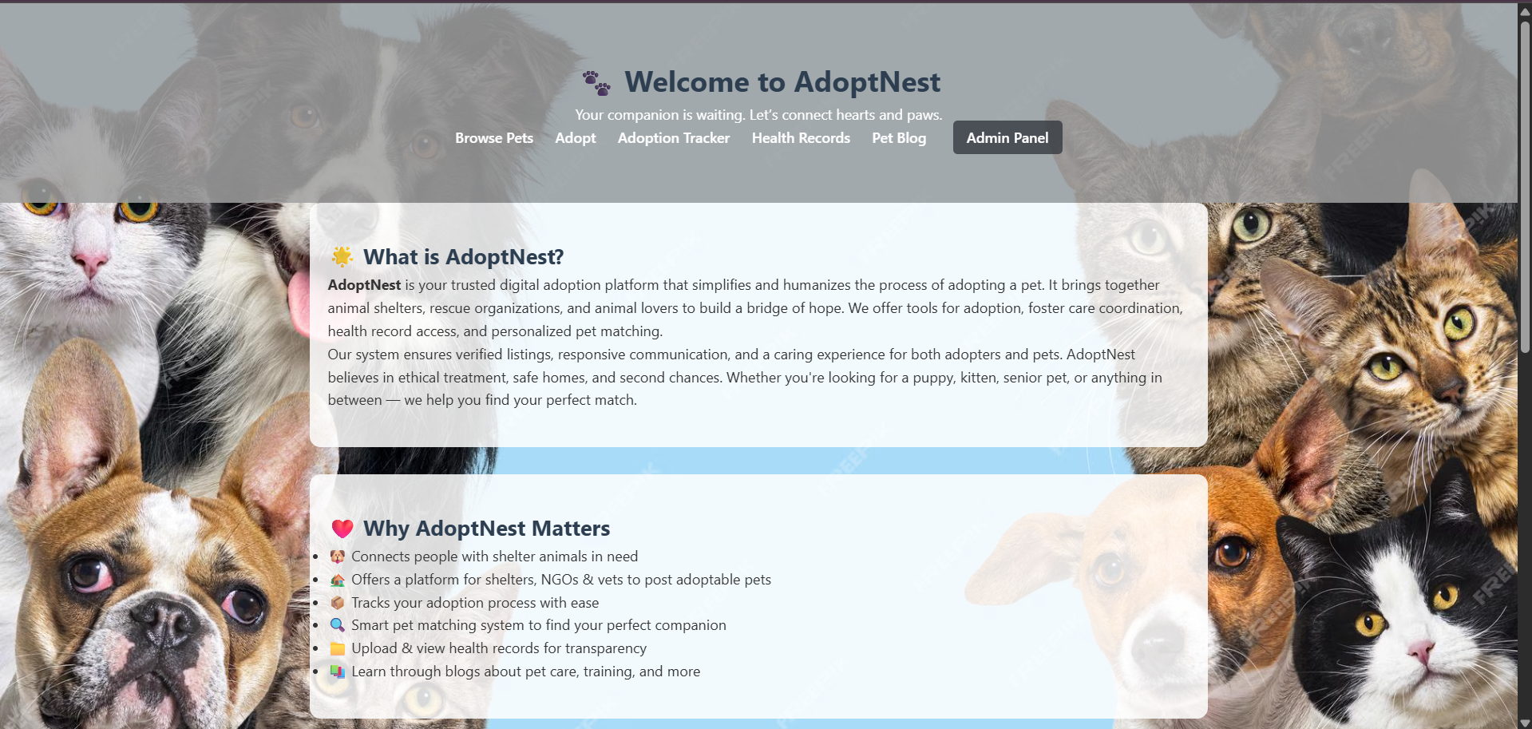
SCREENSHOTS

Slide 24
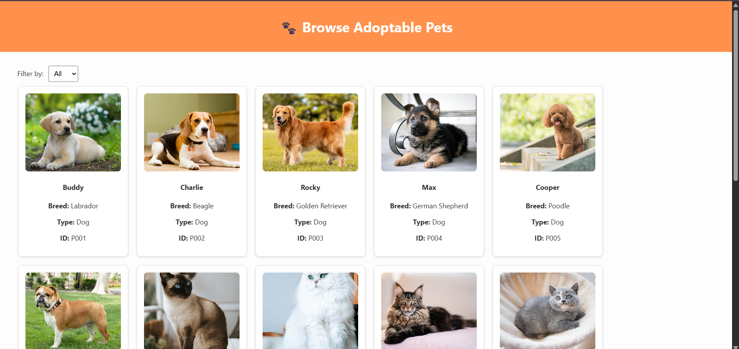
SCREENSHOTS

Slide 25
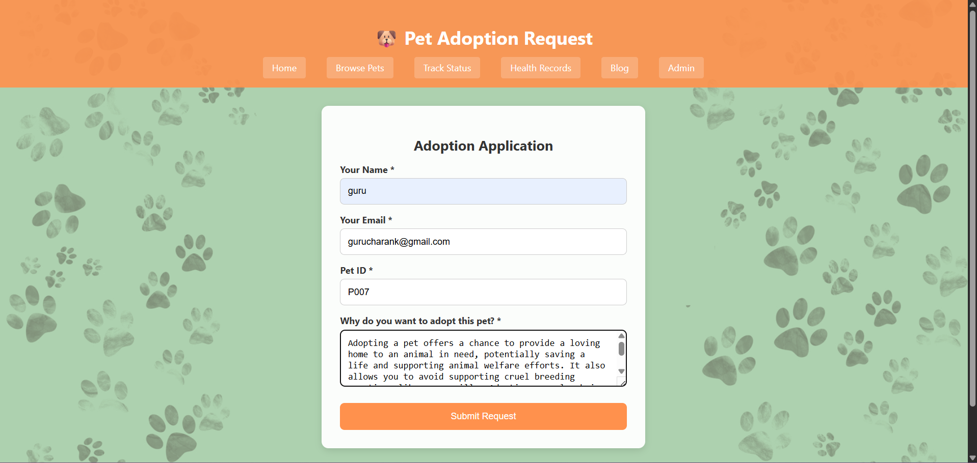
SCREENSHOTS

Slide 26
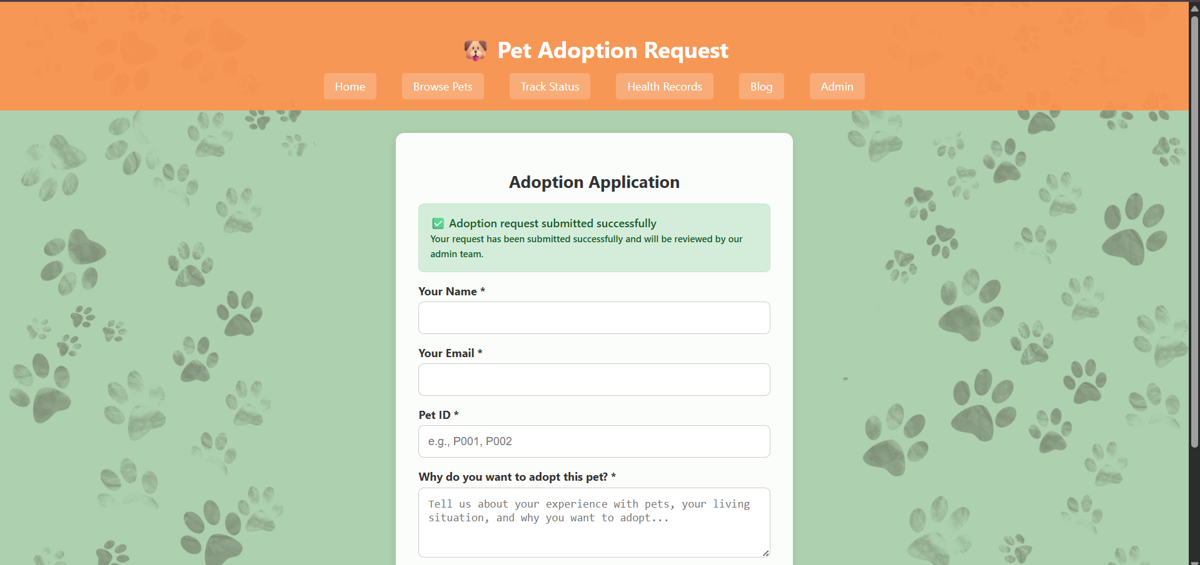
SCREENSHOTS

Slide 27
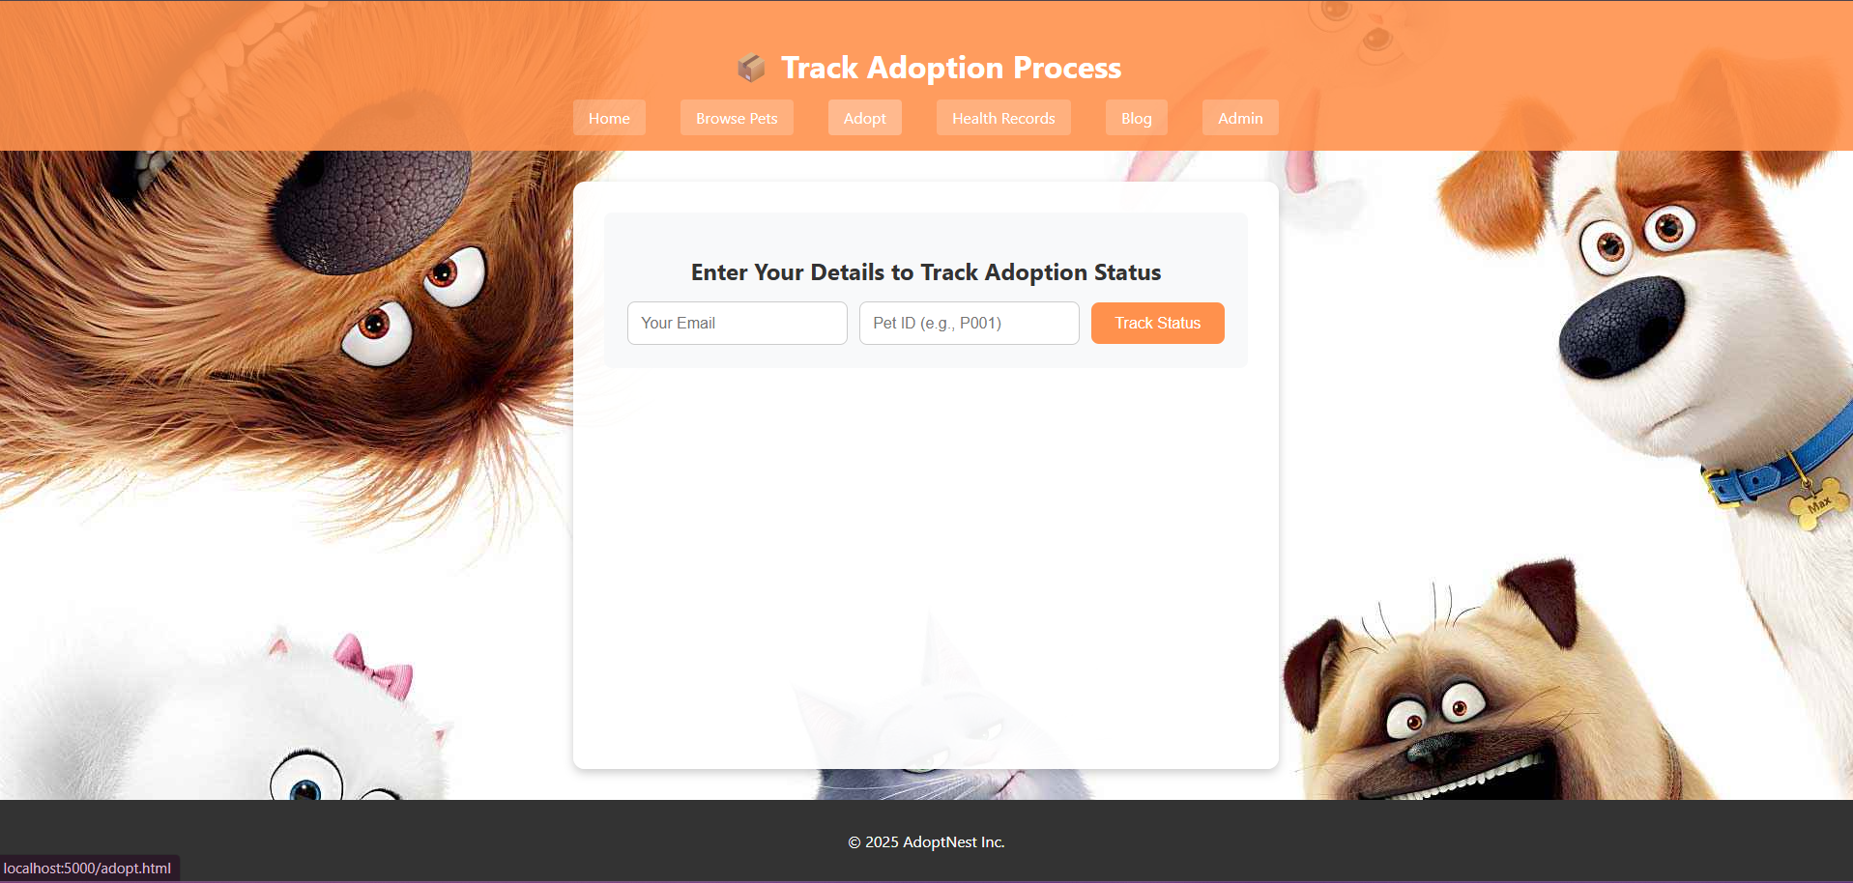
SCREENSHOTS

Slide 28
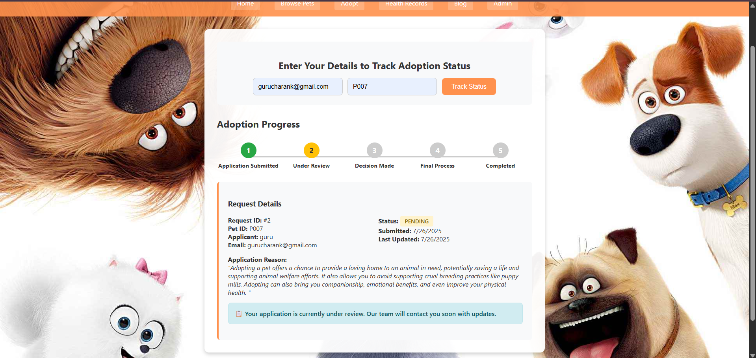
SCREENSHOTS

Slide 29
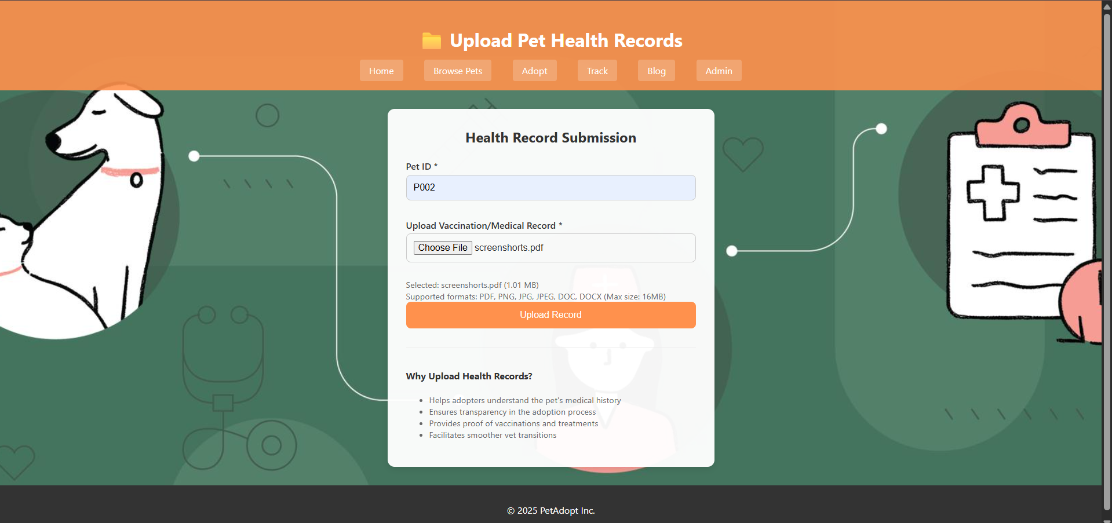
SCREENSHOTS

Slide 30
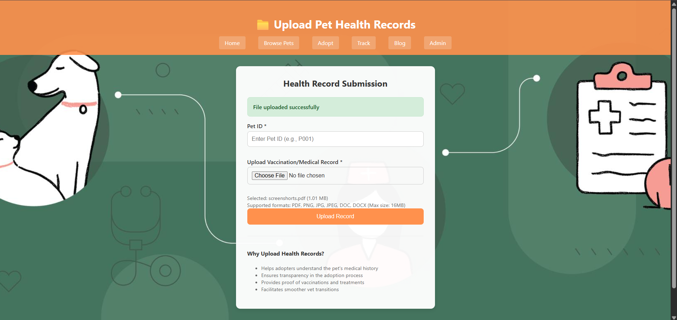
SCREENSHOTS

Slide 31
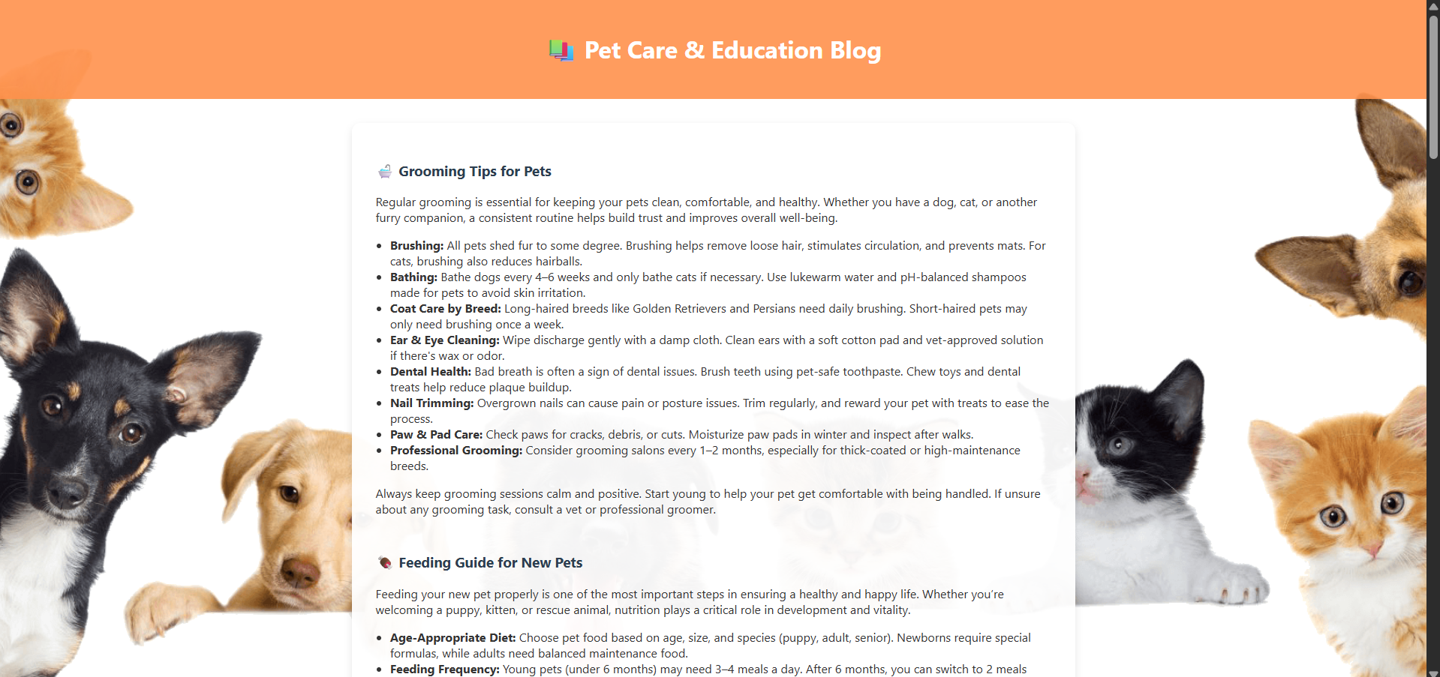
SCREENSHOTS

Slide 32
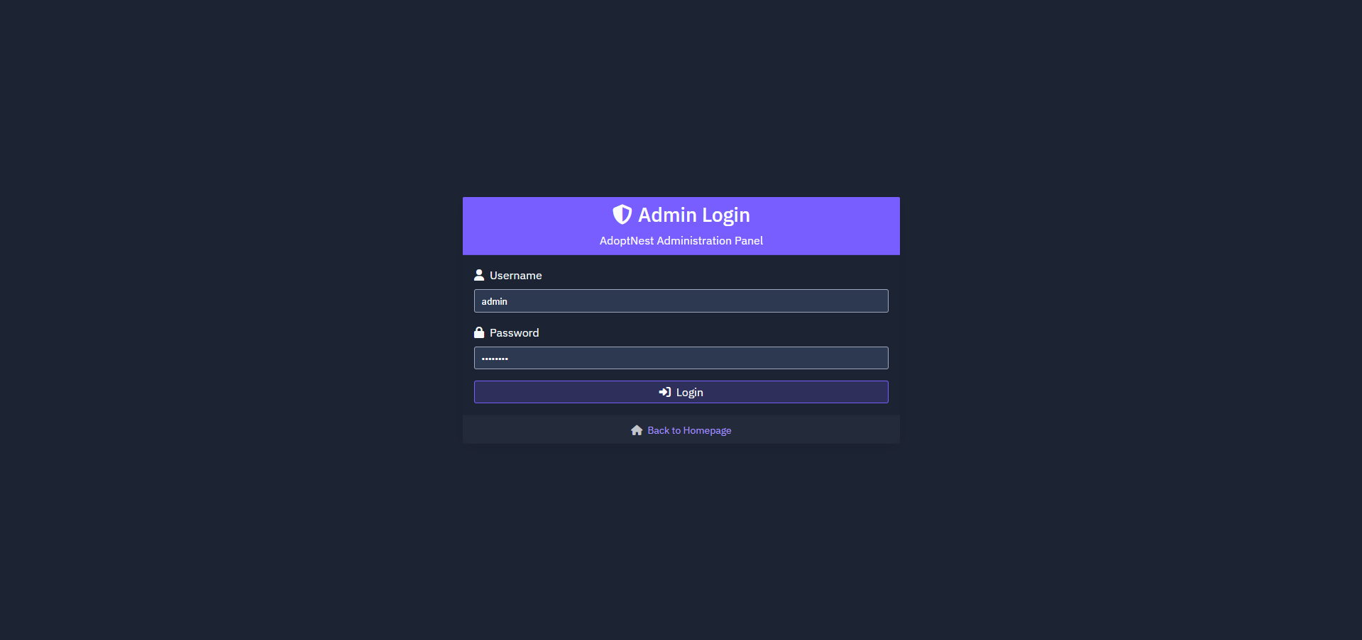
SCREENSHOTS

Slide 33
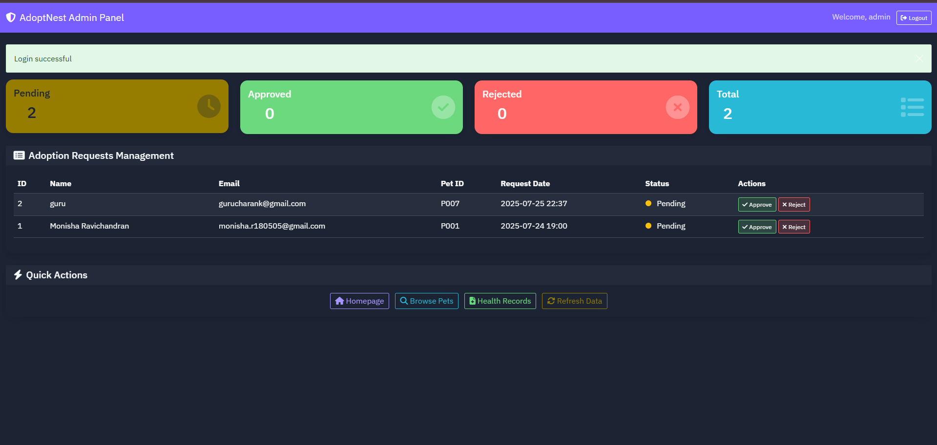
SCREENSHOTS

